Slide 1
Docker Hosting
Old Way Application on Host VS The new Way: Deploy Containers

Slide 2
The old way Application on Host The new Way: Deploy Containers
APP
APP
APP
APP
APP
APP
Libraries
Libraries
LIBRARIES
App
APP
Libraries
Libraries
Kernel
Kernel

Slide 3
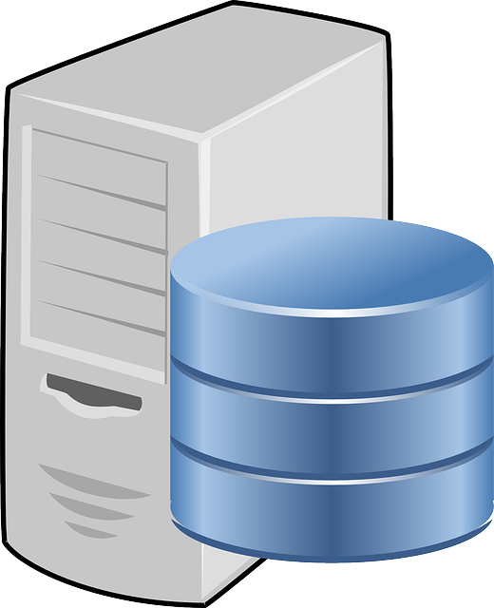
How to Use Docker?
Container
STAGING
Server
Virtual Machine
Docker HUB
Docker Image
Docker File
Project Code
Docker
Container
Production
Server
Container

Slide 4

How Do I build Docker Image?
This Photo by Unknown Author is licensed under CC BY-SA

Slide 5
Go TO Docker Hub
Repositories
Click
Create Repository
Docker.com
Pull Docker Images
Docker
Container
Run Docker Images
To create Docker
Container

Slide 6
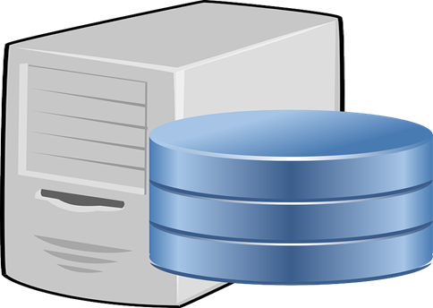
How to Build Docker Images? – Using DockerFile
Repositories
Docker.com
Create Repositories
Run
ENV
DockerFile
From
Expose
Base Image
Maintainer
USER
ADD
Volume
CMD
WORKDIR
EntryPoint

Slide 7
DockFile syntax consists of two main blocks
Comments
Commands + arguments

